Slide 1















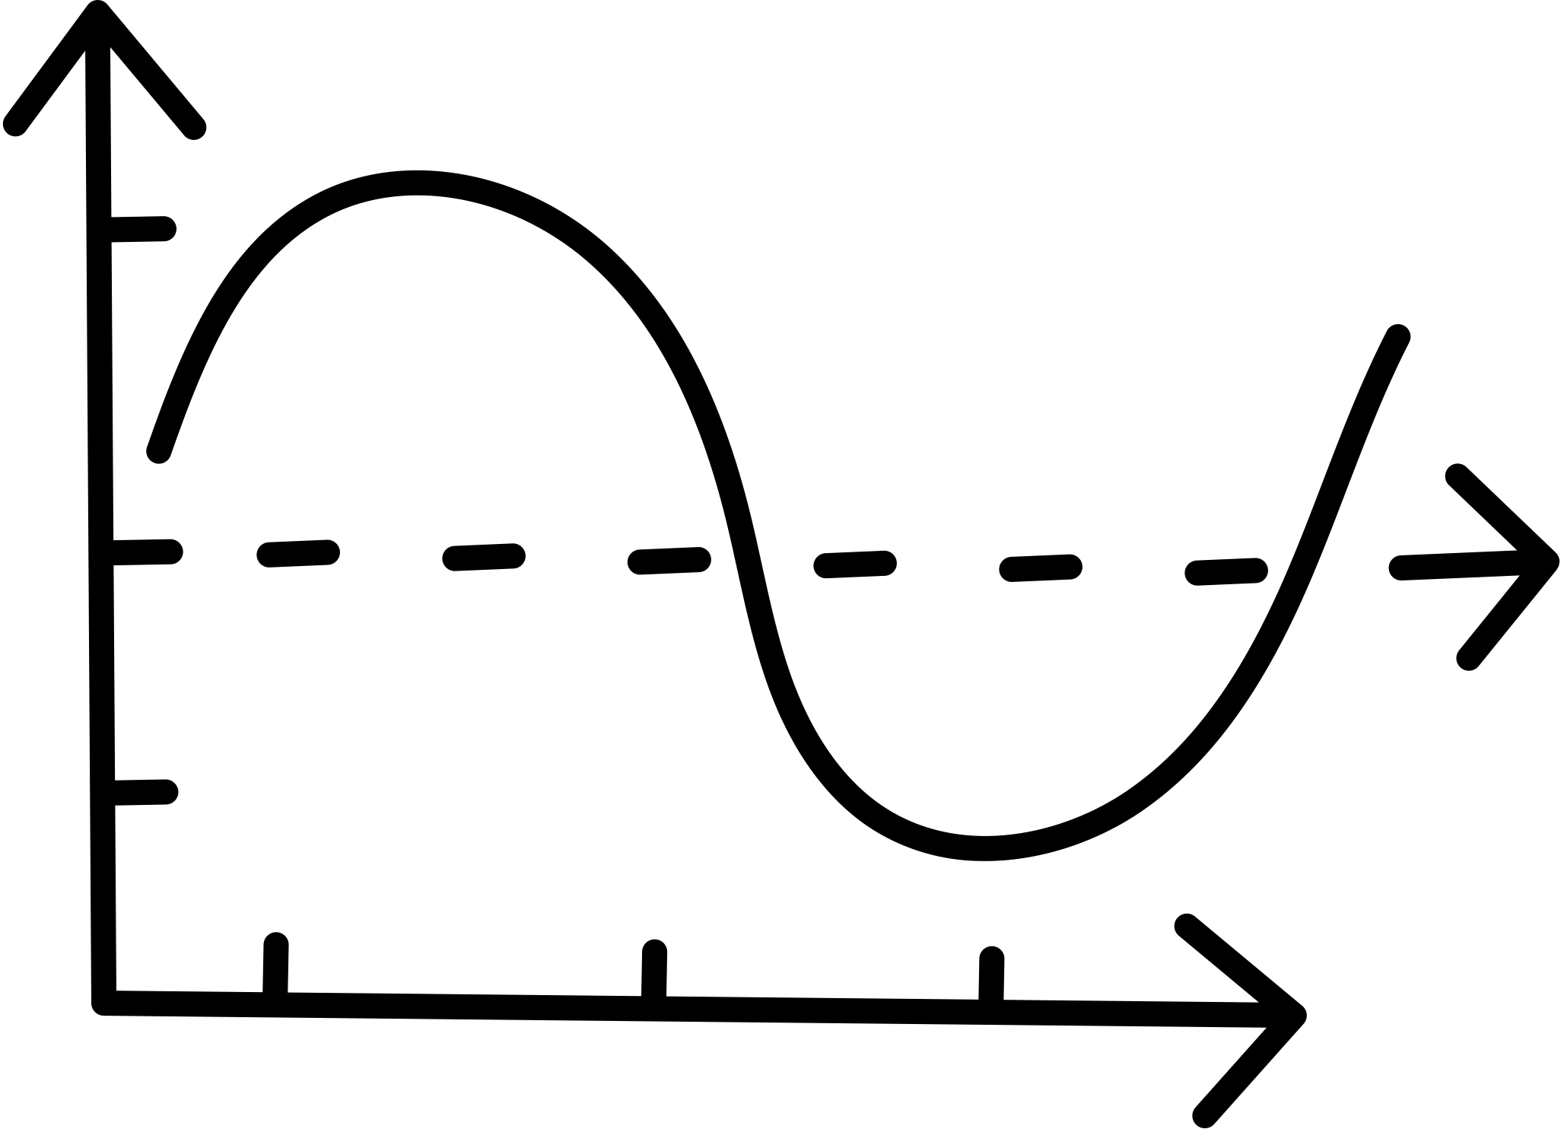

Building Innovative Youth Ministry
With Young People
Megan DeWald
Director, Institute for Youth Ministry
Princeton Theological Seminary
iym.ptsem.edu

Slide 2



Events: Princeton Forum on Youth Ministry & The Online Forum on Youth Ministry
Programs: Certificate in Youth and Theology & the Log College Project
Resources: Disrupting Ministry Podcast

Slide 3









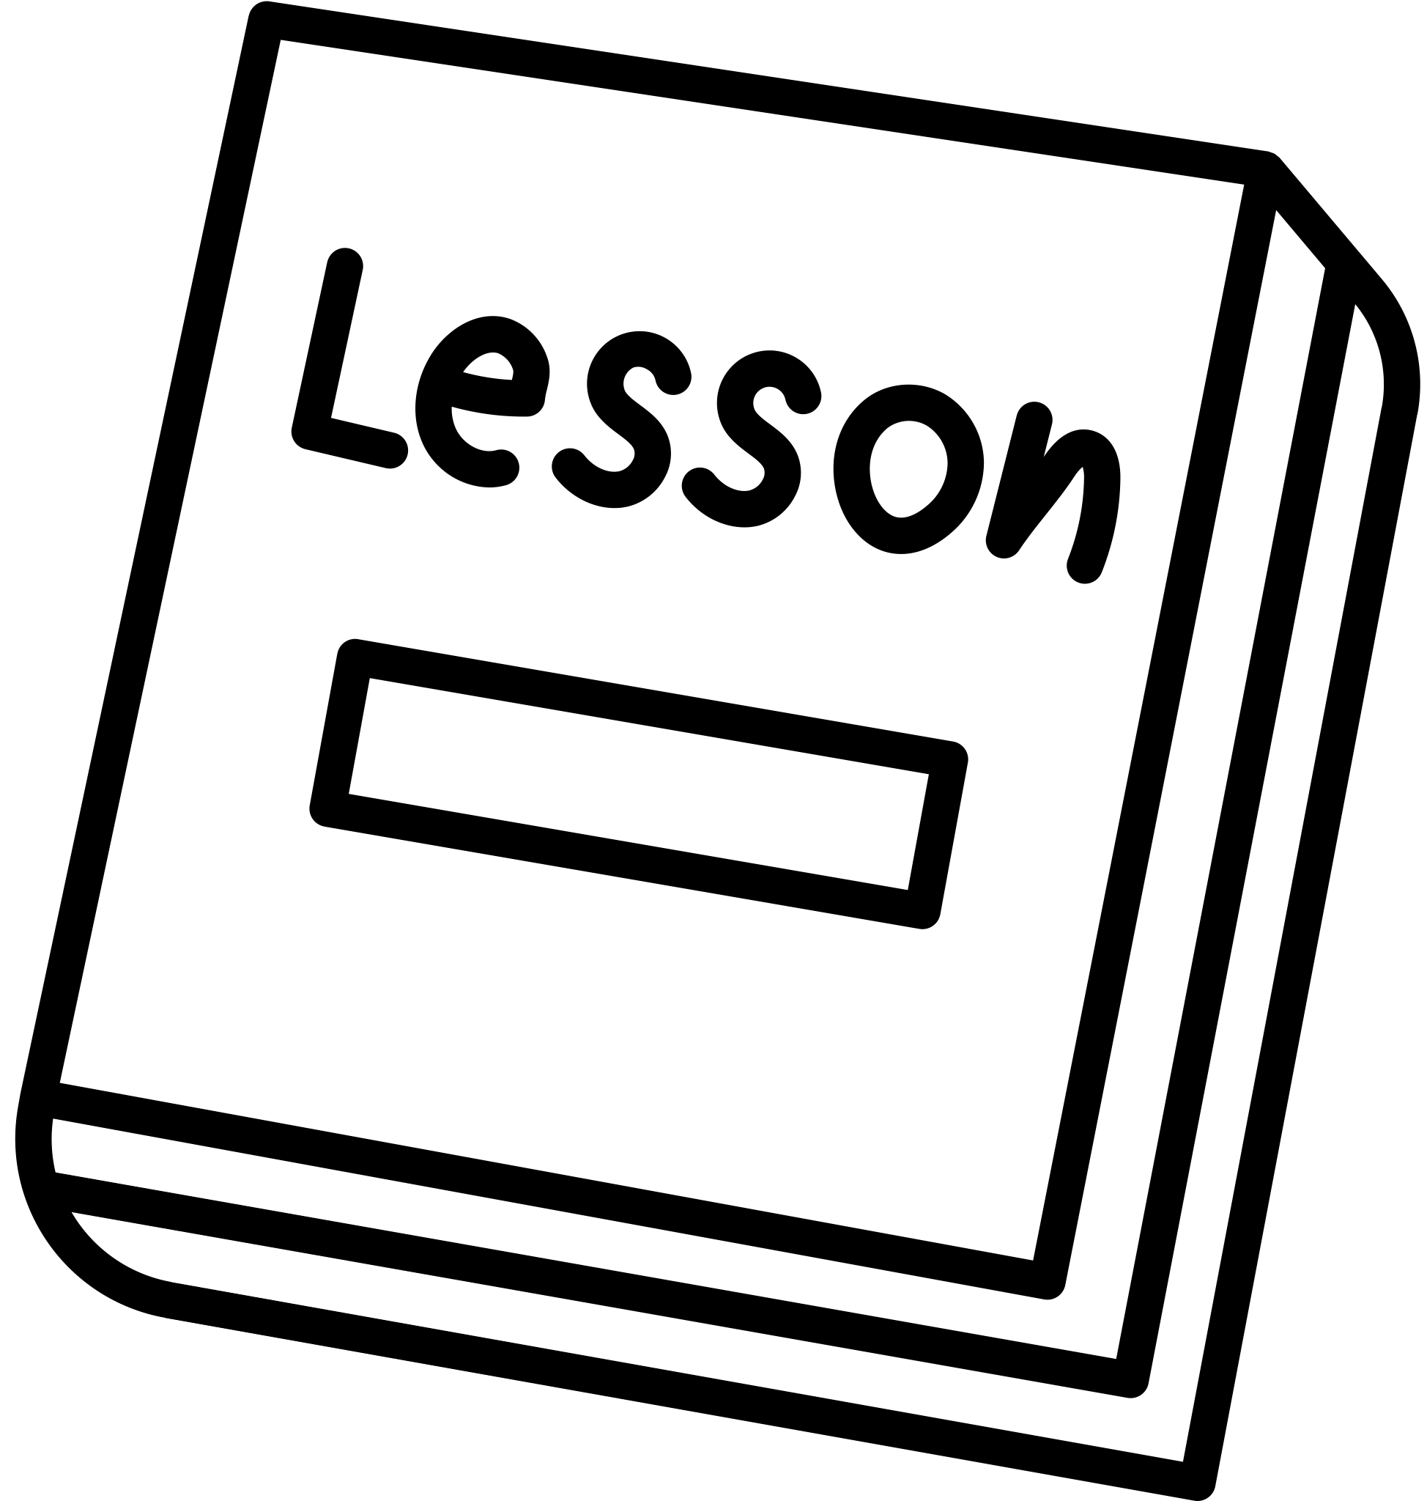

1
Getting to Know Each Other
Workshop
Agenda
The Job to Be Done Theory
2
3
A Design Challenge
4
Prototype Your Idea

Slide 4



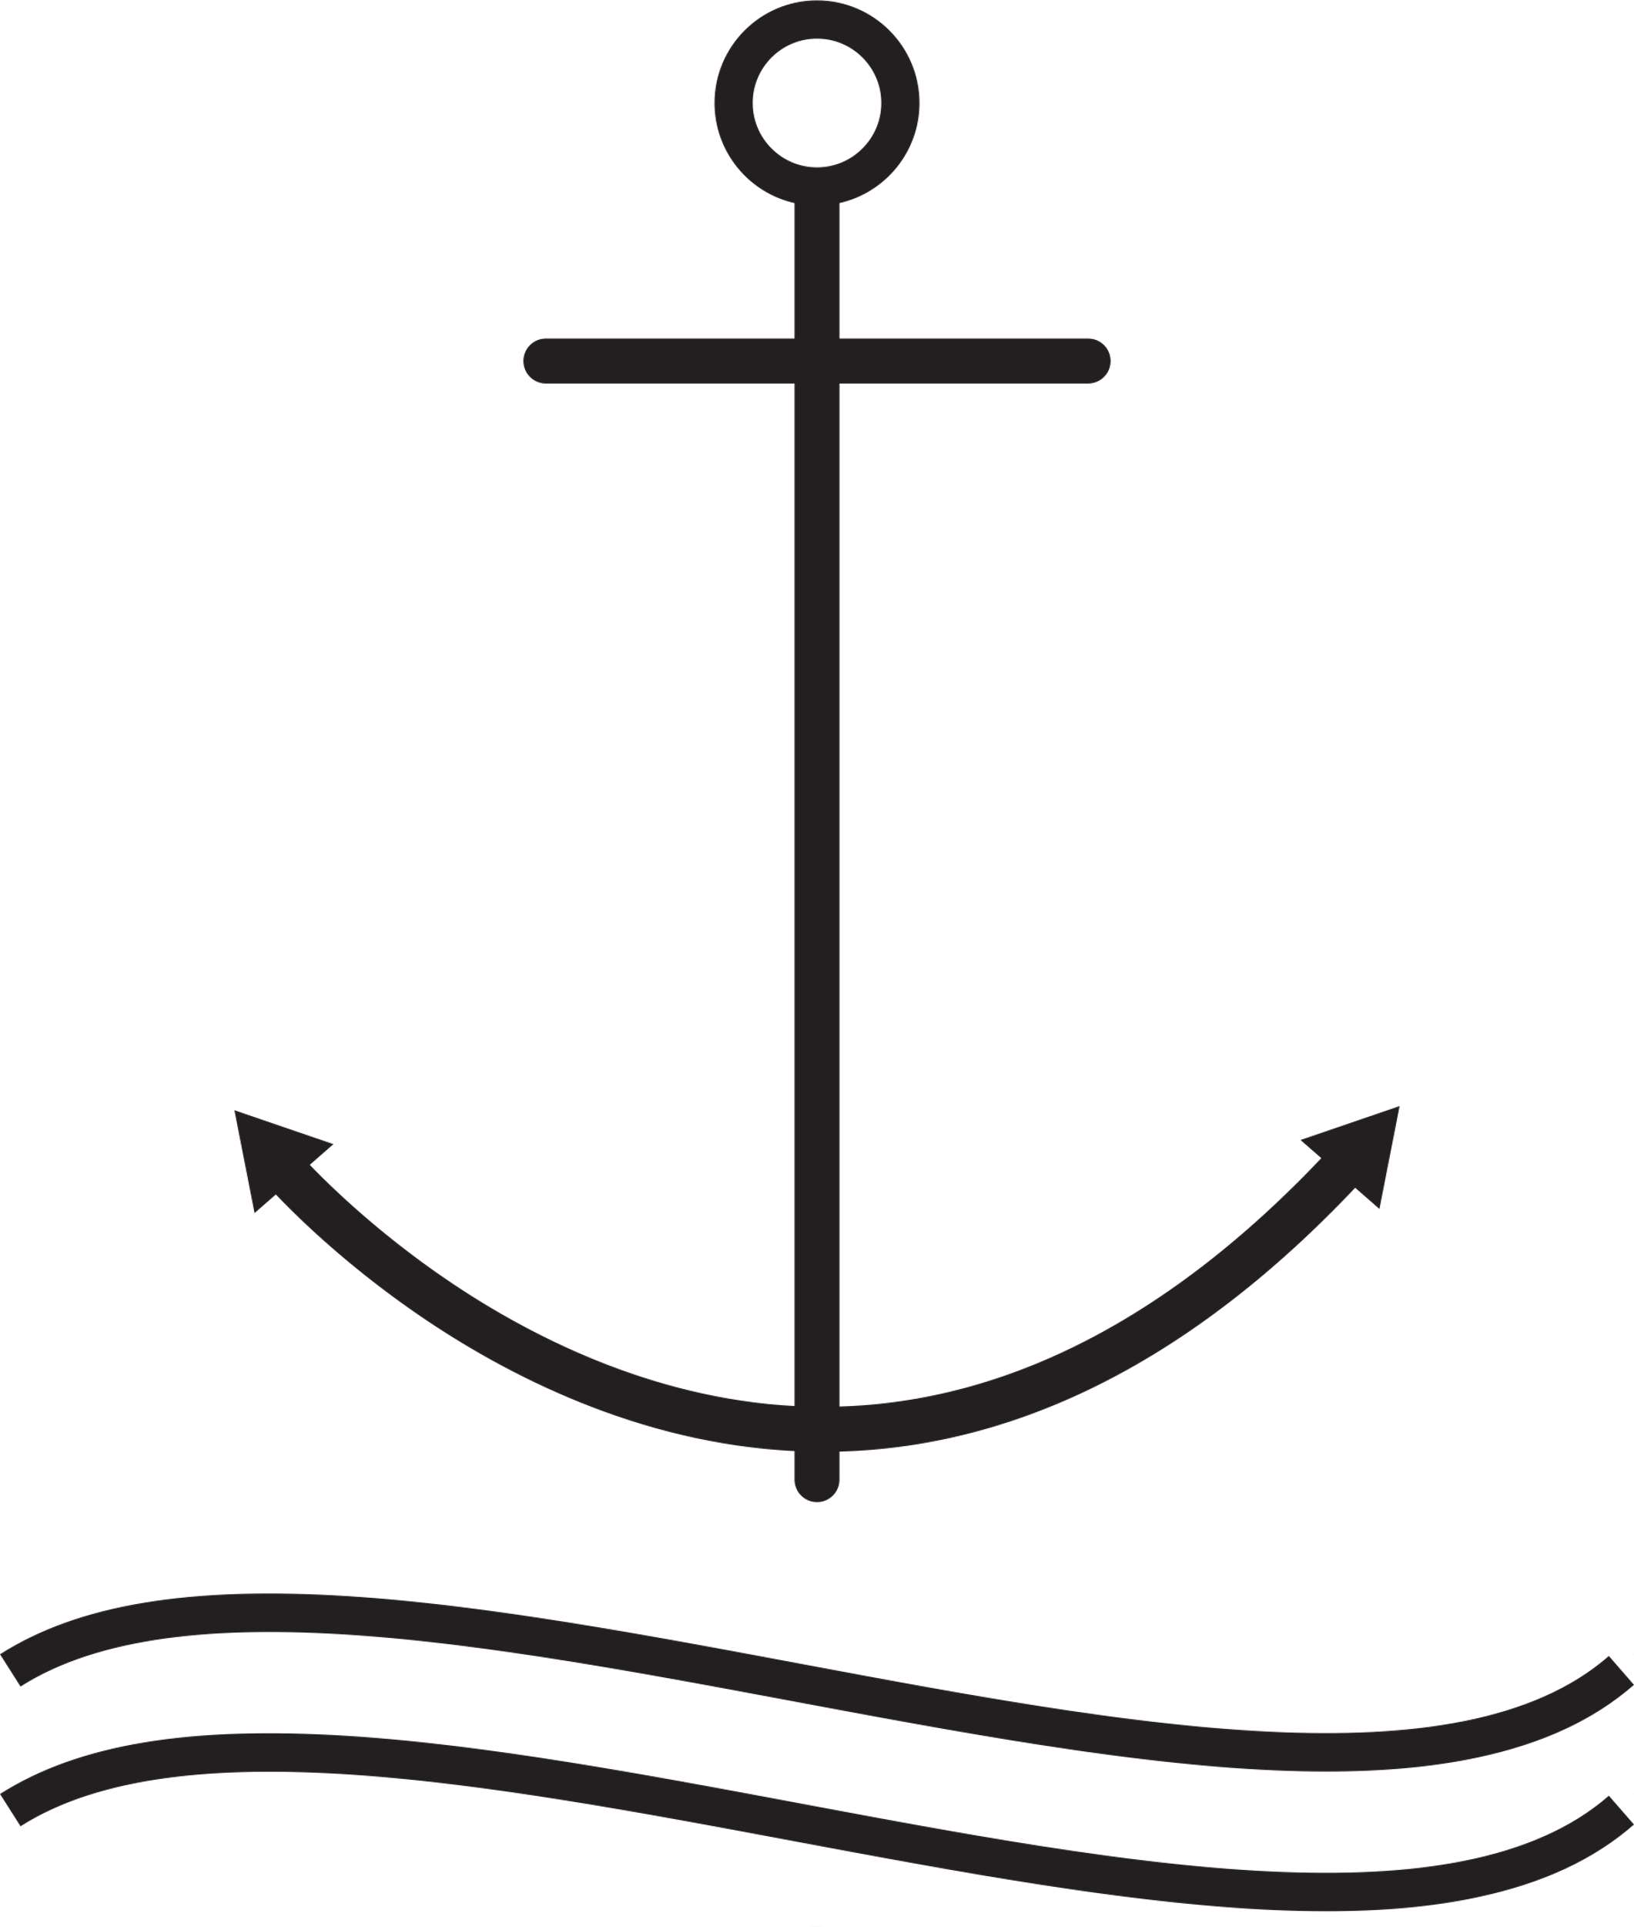



Getting to Know Each Other
Name & pronouns
Church & Location
Name an Anchor & a Sail in Your Ministry

Slide 5




The Job to Be Done
Observations
Small is good. Small is all.
Change is constant.
Never a failure. Always a lesson.
Less prep. More presence.
principles of emergent strategy from adrienne maree brown's book, emergent strategy (2017)

Slide 6
The Job to Be Done
Observations
Time of Day When Purchase Happened
Customer’s Reason for Purchasing
Surprise competition for business
Small is good. Small is all.
Change is constant.
Never a failure. Always a lesson.
Less prep. More presence.
principles of emergent strategy from adrienne maree brown's book, emergent strategy (2017)

Slide 7
The Job to Be Done
Hypotheses
Small is good. Small is all.
Change is constant.
Never a failure. Always a lesson.
Less prep. More presence.
principles of emergent strategy from adrienne maree brown's book, emergent strategy (2017)

Slide 8

















Brain & Bio Break

Slide 9




Empathize
Define
Prototype
Ideate
Test
Design Thinking

Slide 10
Building Innovative Youth Ministry
With Young People
Megan DeWald
Director, Institute for Youth Ministry
Princeton Theological Seminary
iym.ptsem.edu

